Slide 1

Session 7-8
Legislative and regulatory requirements relating to contributing to cyber security risk management
Understanding organisational policies and procedures,
Developing suitable cyber security response options according to organisational policies and procedures

Slide 2
Legislative and regulatory requirements relating to contributing to cyber security risk management
data protection legislation
notifiable data breach legislation
Australian privacy laws
established international legislation

Slide 3
Legislative and regulatory requirements relating to contributing to cyber security risk management
The current legislation that regulates how personal information is handled in Australia is the Privacy Act 1988 and is supported by the Privacy Regulations 2013. These laws apply to public sector and government organisations, as well as some private sector organisations.
Privacy Act 1988
A legal document that sets out the rules for businesses to follow.
Outlines the requirements on how to collect, use, store and disclose personal information.
Protects your personal information privacy, not your physical privacy (Physical privacy is protected by the Australian Human Rights Commission Act 1986)
Contains the 13 Australian Privacy Principles (APPs) – principles provide guidance on how personal information should be handled.

Slide 4
Legislative and regulatory requirements relating to contributing to cyber security risk management
The 13 Australian Privacy Principles (13 APPs):
APP 01 – Open and transparent management of personal information
APP 02 – Anonymity and pseudonymity
APP 03 – Collection of solicited personal information
APP 04 – Dealing with unsolicited personal information
APP 05 – Notification of the collection of personal information
APP 06 – Use or disclosure of personal information
APP 07 – Direct marketing
APP 08 – Cross-border disclosure of personal information
APP 09 – Adoption, use or disclosure of government related identifiers
APP 10 – Quality of personal information
APP 11 – Security of personal information
APP 12 – Access to personal information
APP 13 – Correction of personal information

Slide 5
Legislative and regulatory requirements relating to contributing to cyber security risk management
AS ISO 19600:2015 / major Australian regulators
risk management: AS/ISO 19600 states that ‘compliance risk assessment constitutes the basis for the implementation of the compliance management system’. This is a significant inclusion as it makes risk management an essential part of a compliance program.
Notifiable data breach scheme
Under the Notifiable Data Breaches (NDB) scheme any organisation or agency the Privacy Act 1988 covers must notify affected individuals and the OAIC when a data breach is likely to result in serious harm to an individual whose personal information is involved.

Slide 6
Legislative and regulatory requirements relating to contributing to cyber security risk management
EU General Data Protection Regulations
The General Data Protection Regulation (GDPR) is the toughest privacy and security law in the world. Though it was drafted and passed by the European Union (EU), it imposes obligations onto organizations anywhere, so long as they target or collect data related to people in the EU.
The regulation was put into effect on May 25, 2018. The GDPR will levy harsh fines against those who violate its privacy and security standards, with penalties reaching into the tens of millions of euros.

Slide 7
Organisational policies and procedures
Common risk management frameworks:
NIST
ITIL
ISO31000:2018
While developed by different organisations, the processes within these mentioned frameworks are similar.

Slide 8
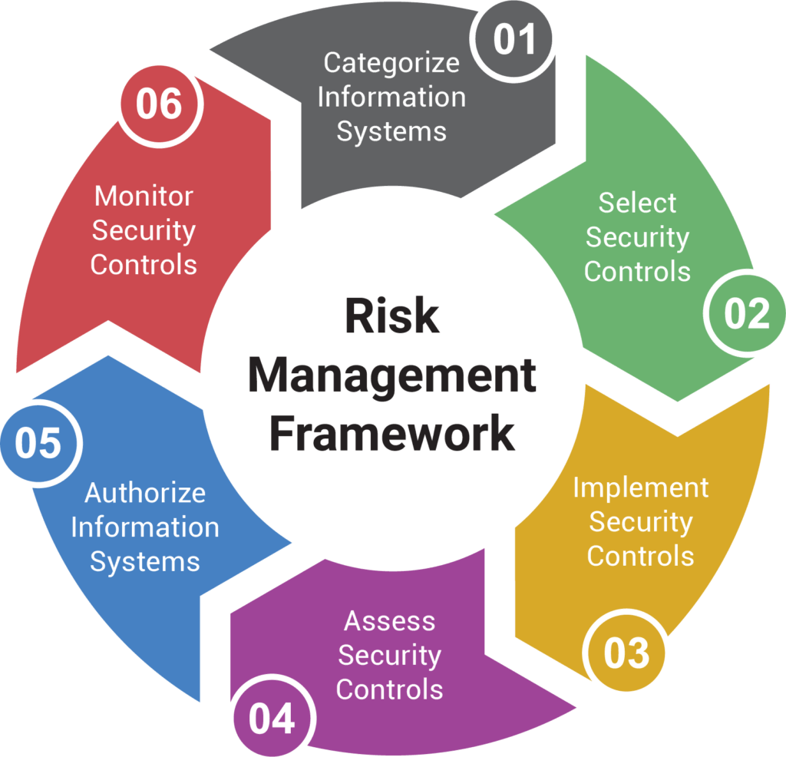
Organisational policies and procedures

Slide 9
Organisational policies and procedures
Developing Communication Plans
Communication and consultation is an essential attribute of good risk management. Risk management cannot be done in isolation and is fundamentally communicative and consultative. Hence this step is, in practice, a requirement within each element of the risk management process.
Formal risk reporting is only one form of risk communication. Good risk communication plans generally includes the following attributes:
encourages stakeholder engagement and accountability
maximizes the information obtained to reduce uncertainty
meets the reporting and assurance needs of stakeholders
ensures that relevant expertise is drawn upon to inform each step of the process
informs other entity processes such as corporate planning and resource allocation.
Different stakeholders will have different communication needs and expectations. Good risk communication is tailored to these requirements.

Slide 10
Organisational policies and procedures
Evaluating effectiveness of risk management strategies
Steps to evaluate effectiveness:
Match the Outcomes of a Risk Management Plans with its Objectives
Assess the outcomes of the risk management strategy against expectations. Check if risks are avoided, transferred, mitigated or accepted according to plans. Quantify results where possible to obtain a measurable result.
Evaluate If All the Activities in the Plan are Effective
There are many different components that make up the overall strategy, evaluate each component to ensure that they are providing the expected outcomes. The strategy is only as strong as the weakest link.
Evaluate the Business Environment
Strategies don’t only affect cyber risks, do evaluate if your strategies have affected the business environment. E.g. You do not want customers to be complaining over a complicated authentication process to log on to the customers’ online portal.
Identify areas of improvements
After evaluating the effectiveness and efficiency of all the activities, try to make possible changes in the action plan to get desired results. It may be very time consuming but is necessary for successful implementation of your risk management plan.

Slide 11
Organisational policies and procedures
Monitoring Cyber Risks
Risks change over time and hence risk management will be most effective where it is dynamic and evolving. Monitoring and review is integral to successful risk management and entities may wish to consider articulating who is responsible for conducting monitoring and review activities.
Key objectives of cyber risk monitoring and review include:
• detecting changes in the internal and external environment, including evolving entity objectives and strategies
• identifying new or emerging risks
• ensuring the continued effectiveness and relevance of controls and the implementation of treatment programs
• obtaining further information to improve the understanding and management of already identified risks
• analysing and learning lessons from events, including near-misses, successes and failures
Monitoring and review can be both periodic and based upon trigger events or changing circumstances. The frequency of the review process should be commensurate with the rate at which the entity and its operating environment is changing.
The results and observations from monitoring and review are most useful when well documented and shared. They may be included in formal risk reports be recorded and published internally and externally as appropriate and should also be used as an input to reviews of the whole risk management framework.

Slide 12
Organisational policies and procedures
Monitoring Cyber Risks
Risks change over time and hence risk management will be most effective where it is dynamic and evolving. Monitoring and review is integral to successful risk management and entities may wish to consider articulating who is responsible for conducting monitoring and review activities.
Key objectives of cyber risk monitoring and review include:
• detecting changes in the internal and external environment, including evolving entity objectives and strategies
• identifying new or emerging risks
• ensuring the continued effectiveness and relevance of controls and the implementation of treatment programs
• obtaining further information to improve the understanding and management of already identified risks
• analysing and learning lessons from events, including near-misses, successes and failures
Monitoring and review can be both periodic and based upon trigger events or changing circumstances. The frequency of the review process should be commensurate with the rate at which the entity and its operating environment is changing.
The results and observations from monitoring and review are most useful when well documented and shared. They may be included in formal risk reports be recorded and published internally and externally as appropriate and should also be used as an input to reviews of the whole risk management framework.

Slide 13
Organisational policies and procedures
Reviewing currency of risk register
The threat and risk landscape changes all the time, organisations need to monitor and review the changes periodically to ensure that the controls in place are suitable for the current landscape.
Common factors that contribute to this changes includes:
New IT asset addition to the infrastructure.
Technology advancement
Changes in work procedures
New threats in the wild

Slide 14
Identifying new assets
Introduction of new assets to the infrastructure will create new risks, organizations must identify the additions in order to manage the threats and risks associated.
New projects may involve several types of assets to be added to the infrastructure.
Occasionally, it may just be an expansion of the current IT asset register whereby there is an increased number of the existing assets. (E.g. more desktops purchased for new employees)
Reminder: Assets can come in the form of hardware, software as well as intangible assets like employee's knowledge.

Slide 15
Technology advancement
As technology advances, new systems will be created, or changes will be made to existing systems. This process will inevitably introduce new threats and risks to the organisation.
Common technology advancements that creates new threats and risks may include:
New technologies/products
Software/firmware updates
Additional features to existing technology

Slide 16
Changes in work procedures
When there are changes in work procedures, the organisation should relook at their risk landscape. Changes to work procedures may increase/decrease the existing risk exposure to cyber threats.
These includes procedures that are not related to ICT as well. (Eg. A change in role or a new employee joining the organisation)
When an existing set of work procedures changes, the current cyber security strategy may not have taken the new procedures into considerations.

Slide 17
New threats in the wild
Sometimes, even if the risk management strategies are current and valid, new threats may arise. These are often referred to as zero-day exploits.
Zero-day exploits are threats to systems where no existing resolution are available.
Interim solutions may be applied to avoid or mitigate against zero-day exploits.

Slide 18
Cyber security standards
NUMBER 1: THE AUSTRALIAN SIGNALS DIRECTORATE’S TOP FOUR MITIGATION STRATEGIES TO PROTECT YOUR ICT SYSTEM
The Australian Signals Directorate (ASD) is the Commonwealth’s peak advisory body on cyber security. Its 2012 publication, Top four mitigation strategies to protect your ICT system, sets out four cyber security strategies which it says, if implemented, can address up to 85% of targeted cyber intrusions. The Top four mitigation strategies to protect your ICT system are a subset of a wider suite of ASD’s published cyber security strategies.

Slide 19
Cyber security standards
NUMBER 2: THE AUSTRALIAN GOVERNMENT CYBER SECURITY OPERATIONS CENTRE’S QUESTIONS SENIOR MANAGEMENT NEED TO BE ASKING ABOUT CYBER SECURITY
The Cyber Security Operations Centre (CSOC) is a joint agency under the responsibility of the Commonwealth Attorney-General and the Minister for Defence. The CSOC suggests that senior management should be asking the following questions:
• What would a serious cyber incident cost our organisation?
• Who would benefit from having access to our information?
• What makes us secure against threats?
• Is the behaviour of our staff enabling a strong security culture?
• Are we ready to respond to a cyber security incident?
• Has the organisation applied ASD’s top four mitigation strategies?

Slide 20
Cyber security standards
NUMBER 3: ASIC’S CYBER RESILIENCE: HEALTH CHECK
For directors and officers of corporations and other ASIC regulated entities, this guidance from the regulator should be compulsory reading. The Cyber Resilience: Health Check (ASIC Report 429) contains a number of ‘Health Check Prompts’ which provide useful guidance as to the questions directors and officers can ask in assessing their organisation’s awareness of and preparedness for cyber security issues.
The Report notes:
• for listed entities, a cyber attack may need to be disclosed as market-sensitive information
• cyber risks may need to be disclosed in Product Disclosure Statements.

Slide 21
Cyber security standards
NUMBER 4: THE OFFICE OF THE AUSTRALIAN INFORMATION COMMISSIONER’S GUIDE TO SECURING PERSONAL INFORMATION – ‘REASONABLE STEPS’ TO PROTECT PERSONAL INFORMATION
The Privacy Act 1988 requires regulated entities to ‘take such steps as are reasonable in the circumstances’ to protect personal information from misuse, interference and loss; and from unauthorised access, modification or disclosure (Australian Privacy Principle (APP) no. 11). But what constitutes ‘such steps as are reasonable in the circumstances’?
The OAIC’s Guide to securing personal information – ‘reasonable steps’ to protect personal information provides useful information and should be read in conjunction with the other documents referred to in this article.

Slide 22
Cyber security standards
NUMBER 5: THE PAYMENT CARD INDUSTRY’S DATA SECURITY STANDARD (DSS): REQUIREMENTS AND SECURITY ASSESSMENT PROCEDURE
If your organisation processes card payments, it should comply with the PCI Data Security Standard (DSS): Requirements and Security Assessment Procedures. If your organisation outsources card payment processing, your outsourced service provider should comply with this standard.

Slide 23
Cyber security standards
NUMBER 6: ISO/IEC STANDARDS
The International Organisation for Standardisation (ISO) and the International Electrotechnical Commission (IEC) publish a number of standards used across the IT industry, including specific standards relating to IT security.
The key IT and cyber security standards are the ISO 27000 series. These are highly technical and detailed publications and it is not suggested that directors and officers become experts in these standards and their implementation.
Servea as a useful prompt for a discussion with your IT manager or CIO about whether you, your suppliers and third-party products are or should be ISO/IEC compliant.

Slide 24
Key cybersecurity controls for every business
Security controls are safeguards or countermeasures to avoid, detect, counteract, or minimize security risks to physical property, information, computer systems, or other assets.
For most organisations, information is the most important asset.
Companies are adopting the mindset that it's not if, but when, a cybersecurity attack and data breach will occur.
With these threats in mind, prevention is critical. So is having detection, response, and recovery processes in place before your organisation's or your clients' information is compromised so you can get back to business following a breach.

Slide 25
Cyber security controls
Cybersecurity controls are essential because hackers constantly innovate smarter ways of executing attacks, aided by technological advancements. In response, organizations have to implement the best safeguards to strengthen their security postures. Developing a holistic approach entails adhering to international standards, complying with various regulations, and deploying defense-in-depth strategies.
Cybersecurity controls are the countermeasures that companies implement to detect, prevent, reduce, or counteract to security risks. They are the measures that a business deploys to manage threats targeting computer systems and networks. The controls keep on changing to adapt to an evolving cyber environment. As such, every organization requires to understand the best controls suitable for addressing their security concerns. But first, it is essential to understand the appropriate controls to ensure effectiveness.

Slide 26
Control Types
Physical controls describe anything tangible that’s used to prevent or detect unauthorized access to physical areas, systems, or assets.
Technical controls (also known as logical controls) include hardware or software mechanisms used to protect assets.
Administrative controls refer to policies, procedures, or guidelines that define personnel or business practices in accordance with the organization's security goals.

Slide 27
Control Functions
Preventative controls describe any security measure that’s designed to stop unwanted or unauthorized activity from occurring.
Detective controls describe any security measure taken or solution that’s implemented to detect and alert to unwanted or unauthorized activity in progress or after it has occurred.
Corrective controls include any measures taken to repair damage or restore resources and capabilities to their prior state following an unauthorized or unwanted activity.

Slide 28
Examples of Cyber security controls
Authentication - Employees are required to pass multi factor authentication before gaining access to offices.
Audit Trail - A web server records IP addresses and URLs for each access and retains such information for a period of time as an audit trail.
Training - Employees are trained in defensing computing on an annual basis.
Peer Review - Design changes to a critical system require a secure code review.
Communication - Employees are prohibited from attaching documents to internal emails as they can easily be misaddressed. Instead, employees send a link to a document management system that offers authentication and authorization.
Incident Management - Any employee who loses an electronic device that has been used for work is required to report an incident immediately.

Slide 29
Examples of Cyber security controls
Cryptography - Data in storage is encrypted on all devices.
Passwords - Systems perform validation to ensure employees choose strong passwords.
Processes - An IT governance process reviews security incidents on a monthly basis.
Automation - A website places a three hour freeze on a customer's account if they get their password wrong five times. This dramatically reduces the potential for brute force attacks.
Configuration Management - Changes to firewall rules require an approved change request.
Security Testing - Major system software releases are required to undergo security testing.
AND MANY MORE………

Slide 30
Questions?

